Slide 1
R Software Basics
An overview of the basic concepts and functionality of R software

Slide 2
Introduction to R Software
What is R Software
Why use R Software
Features of R Software

Slide 3
Introduction and history to R
R is a programming language and software environment for statistical computing
It is widely used for data analysis, visualization, and statistical modeling
R provides a wide range of packages and libraries for various tasks
It has a large and active community of users and developers
R is a programming language and free software environment for statistical computing and graphics supported by the R foundation for statistical computing.
R is widely used by statisticians, data analysts and researchers for developing statistical software and data analysis.
It compiles and runs on a wide variety of Unix platforms, windows and mac 0s.The copyright for the primary source code for R is held by the R foundation and is
Published under the GNU general public license version 2.0.
R was created by ross |haka and Robert gentleman at the university of Auckland, new Zealand.+» Currently ris developed & maintained by the R development core team

Slide 4

Features of R
These are the some of important features of R
R is a simple, effective and well-developed, programming language which includes conditionals, loops, user defined & recursive functions and input &output facilities.
R provides a large, coherent and integrated collection of tools for data analysis. R has an effective data handling and storage facility.
R provides a suite of operators for calculations on arrays, lists, vectors and matrices. R provides graphical facilities for data analysis and display either directly at the computer or printing at the papers.
Fast calculation - r can be used to perform complex mathematical and statistical calculations on data objects of a wide variety.
Extreme compatibility = r is an interpreted language which means that it does not need a compiler to make a program from the code, extremely compatible» open source = r is an open-source software environment.
R is machine-independent. It supports open source and the cross-platform operation.
Therefore, it can be used on many different operating systems.
Wide packages - cran houses more than 10,000 different packages and extensions that help solve all sorts of problems in data science. You can make improvements and add packages for additional functionalities cross platform support
Large standard library = R can produce static graphics with production quality visualizations and has extended libraries providing interactive graphic capabilities.

Slide 5
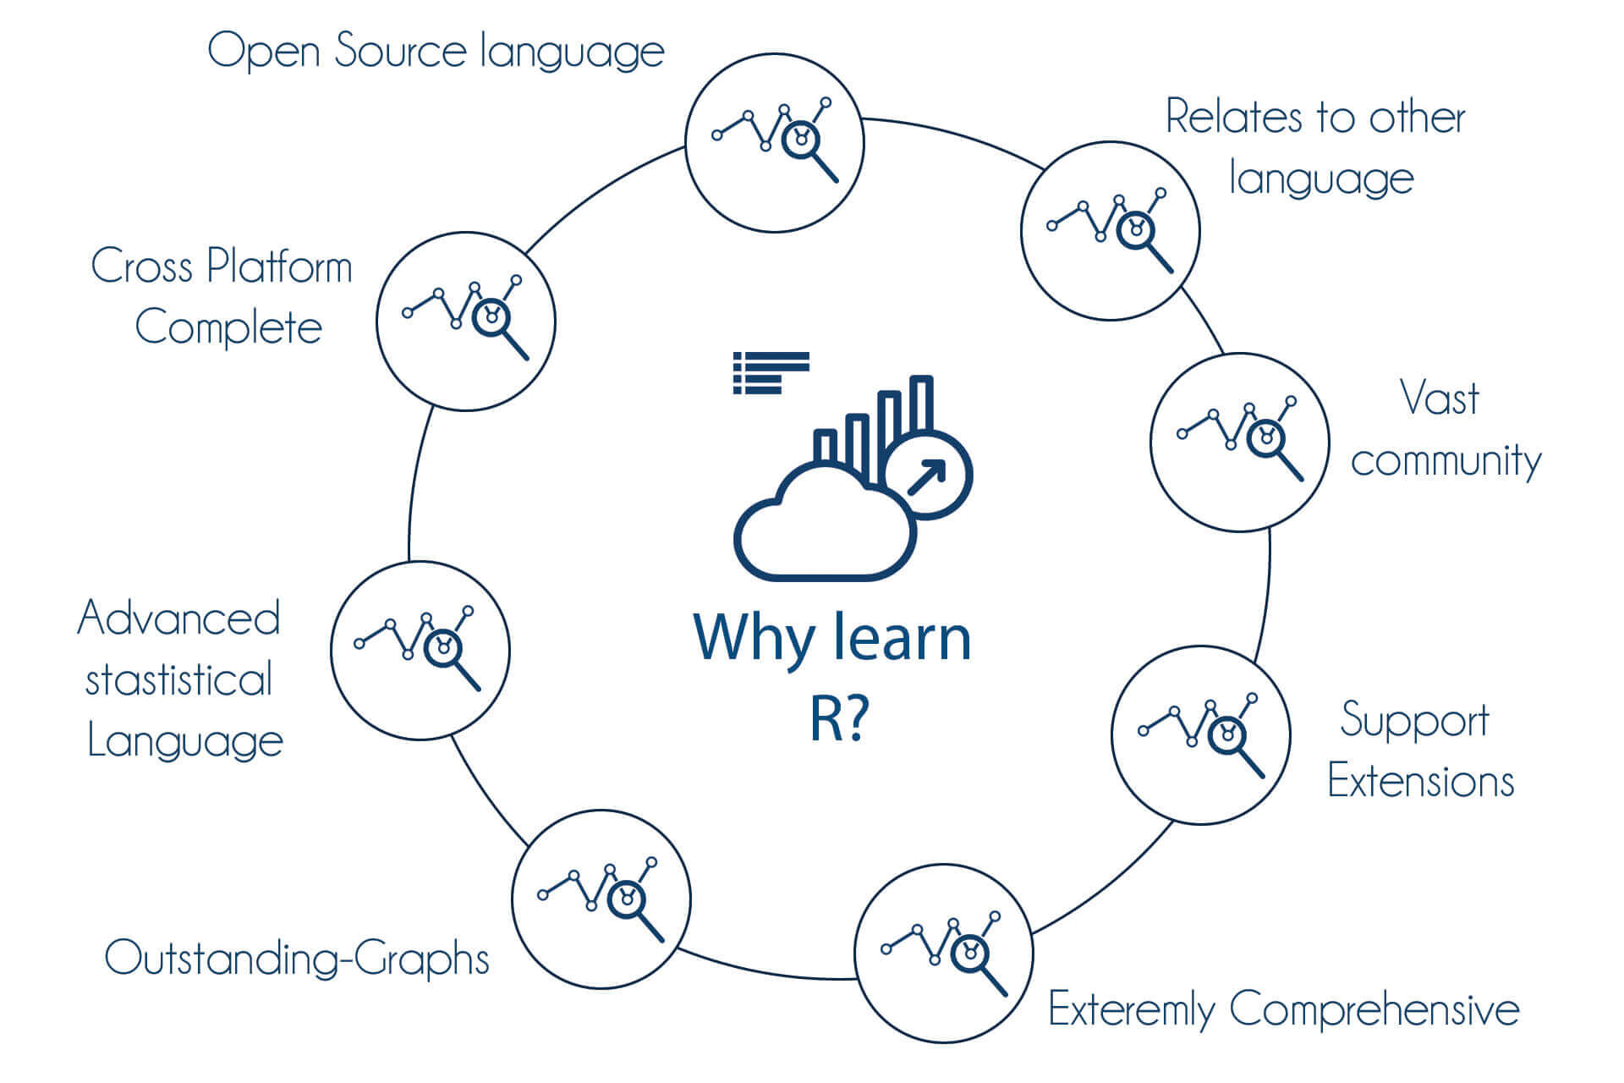

Slide 6
Syntax of R
Once we have R environment setup, then it's easy to start our R command prompt just by typing R in command prompt.
Hello World Program —
>myString<- “Hello World”
>print(myString)
Output =
(1) “Hello World”
The [ ] in the output of R can be used to as the reference to the data frame columns
In the Syntax of R we will discuss
Data Types
Variables
Keywords
Operators
Data Structures

Slide 7
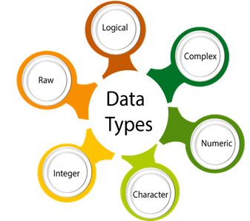
DATA TYPES
In R there are basically 6 data types
DATA TYPES | Examples
Integer | 2L,7L,9L
Numeric | 6,63,4,24
Logical | TRUE,FALSE,0,1
Raw | Raw Bytes
Complex | Z=3+7i
character | ‘R’, “rakesh”,’ AB47’

Slide 8
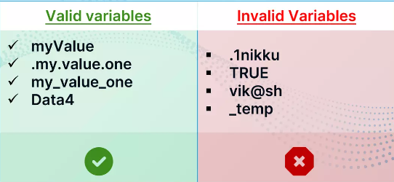
Variables
Rules For Naming Variables in R
In R variable name must be a combination of letters, digits, period(.) And underscores.
It must start with a letter or period(.) And if it starts with period then it period should not be followed by number.
Reserved words in r cannot be used in variable name.

Slide 9
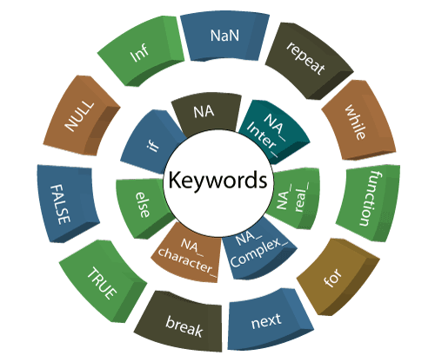
Keywords
Reserved key words in R
Reserved keywords in R - reserved words are set of words that have special meaning and cannot be used as names of identifiers.
A keyword is a word which is reserved by a program because it has a special meaning. A keyword can be a command or a parameter. Like in C, C++, java, python, there is also a set of keywords in R.
A keyword can't be used as a variable name. Keywords are also called as "reserved names."

Slide 10
Operators
Operators in R
In any programming language, an operator is a symbol which is used to represent an action. R has several operators to perform tasks including arithmetic, logical and bitwise operations.
Operators in R can mainly be classified into the following categories –
Arithmetic Operators = {+.-,*./. %% . %/%}
Logical Operators={!, & ,&&, |. ||}
Assignment operators = { <-, <<- = > >>)
Relational Operators={<,>, <=, >= |=,==}

Slide 11
Functions
Operators in R Functions are used to incorporate sets of instruction that you want to use repeatedly. There are two types of functions
Function
Built-In
User Defined

Slide 12
Built-In Functions
Built-in functions are those functions which are provided by R so that we can use directly within the language and its standard libraries.
In R there are so many built-in functions which make our programming fast and easy
For Example :
1.The sum(a,b) function will return (a+b)
>print{sum{10,20))
[1] 30
2.The seq(a,b) function is used to get sequence from a to b
>print{seq(5,15))
[1] 5 6 7 8 9 10 11 12 13 14 15

Slide 13
User Defined Functions
User defined functions are those functions which we define in our code and use them repeatedly.
These functions can be defined with two types.
1.Without Arguments
2.With Arguments
Without Arguments
myFunction <- function()
{
#This will be printed on calling this function print(“Without Arguments”)
}
With Arguments
myFunction <- function(a,b)
{
#This function will print sum of passed args
Print(a+b)
}

Slide 14
Conditional Statements
Conditional Statements in R programming are used to make decisions based on the conditions.
Conditional statements execute sequentially when there is no condition around the statements.
In R language we'll discuss 3 types of conditional statements
1.If - else statements
2.If - else if — else statements
3.Switch statements

Slide 15
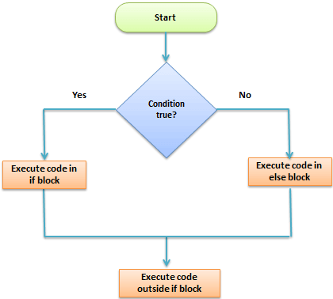
If-Else
Syntax —
If{condition) {
expression 1
}
Else {
expression 2
}
Example —If(a>b) {
print(*a is greater than b")
}
Else {
print(* a is less than b")
}

Slide 16
Switch Statements
Reserved key words in R
In switch() function we pass two types of arguments one is value and others is list of items.
The expression is evaluated based on the value and corresponding item is returned.
“If the value evaluated from the expression matches with more than one item of the list then switch() function returns the item which was matched first.
Examples:
1.
switch(2,"Delhi”,"Jaipur”,"Mumbai”]
[1] “Jaipur”
2.
a=3
>switch(a,"red","blue”,”Green”,”yellow”)
[1] “green”

Slide 17
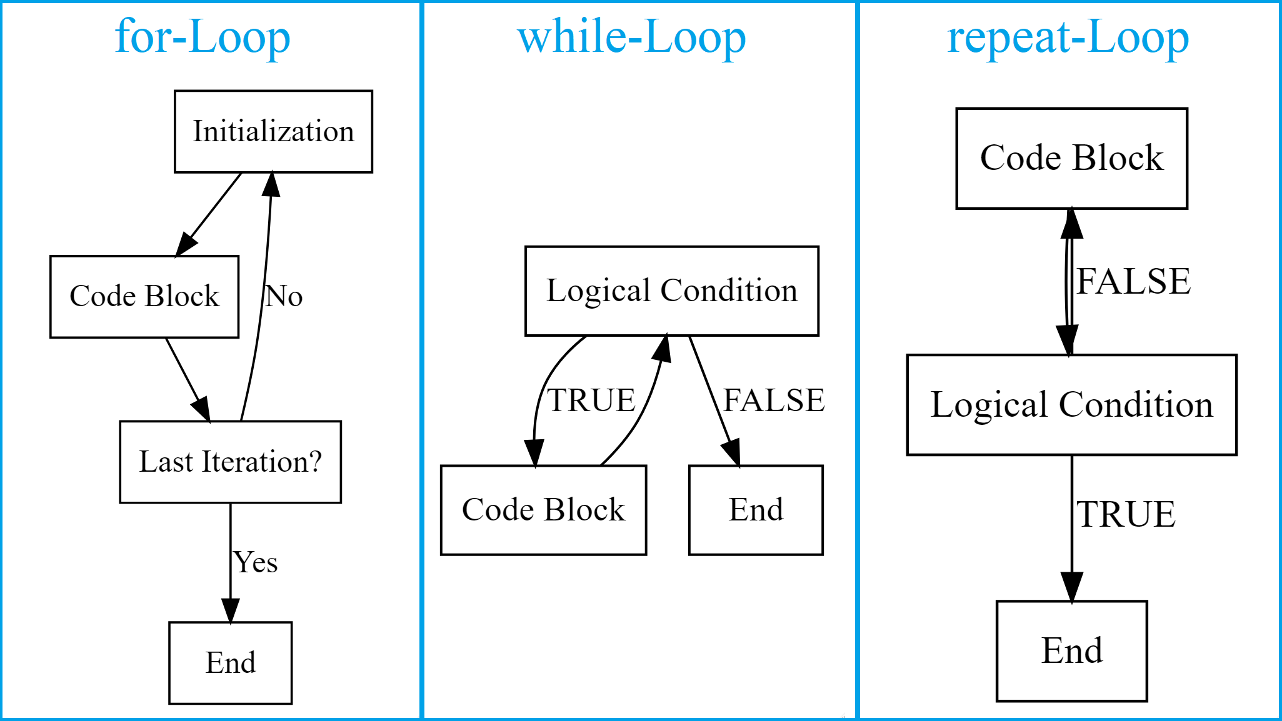
Loops
Loops are used when we need to execute particular code repeatedly.
In r/language there are 3 types of loops
1.For loop
2:While loop
3.Repeat loop

Slide 18
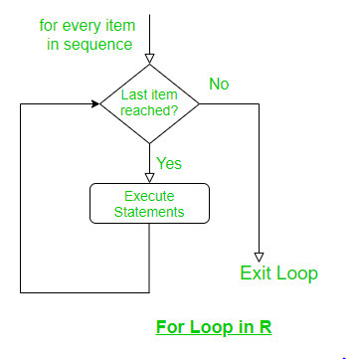
For Loop
A for loop is used to iterate over a vector in R programming.
Example to count the number of even numbers in a vector.
Program
X <-c{2,5,3,9,8,11,6)
count <- 0
for (i in x) {
if (i%% 2 ==0){ count=count+1
}
print{count)
Output =[1] 3

Slide 19
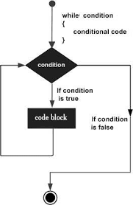
While Loop
While Loop In R programming, while loops are used to loop until a specific condition is met.
Program
i<-1
While(i=5) {
print(i)
i=i+1
}
Output :
[1] 1
[1] 2
[1] 3
[1] 4

Slide 20
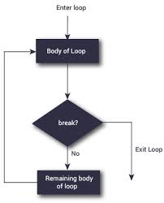
Repeat Loop
A repeat loop is used to iterate over a block of code multiple number of times.
There is no condition check in repeat loop to exit the loop.
We must ourselves put a condition explicitly inside the body of the loop and use the break statement to exit the loop. Failing to do so will result into an infinite loop
Example
x<-1
repeat {
print(x)
x =x+1
if (x == 4) {
break
}
}
Output :
[1] 1
[1] 2
[1] 3

Slide 21
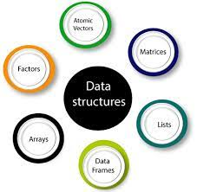
Data Structurers
A data structure is a particular way of organizing data in a computer so that it can be used effectively.
The idea is to reduce the space and time complexities of different tasks. Data structures in R programming are tools for holding multiple values.
The most essential data structures used in R include :
Vectors
Arrays
Factors
Lists
Matrices
Data frames

Slide 22
Vector
Vector is the one of basic data structure of R which supports integer, double, Character, logical, complex and raw data types.
The elements in a vector are known as components of a vector.
VECTOR CREATION
Vector can be created using these two methods :
1.By Using Colon(:) Operator
a<-2-8
print(a)
o/p: #2345678
2.By Using seq() function
a <-seq(2,10,by=2)-
print(a)
o/p: #246810oe : = 24

Slide 23
Vector
Vectors Operations
1.Combining Vectors
2.Arithmetic Operations
3.numeric Indexing
4.Duplicate Indexing
5.Logical Indexing
6.Range Indexing

Slide 24
Array
Arrays allow us to store data in multi - dimensions and use in efficient way.
ARRAY CREATIONS
syntax –
Array_Name <- array(data, dim=(row_size, column_size, matrices), dim_names)
ARRAY OPERATIONS
1.Accessing Array Elements :
Accessing array in R is similar to other programming languages like c,c++ and java.
Eg. Print(Arr[2,2])
2.Arithmetic Operations :
Eg. Arr3<-Arr2+Arr1
Or
Arr=Arr1-Arr2

Slide 25
Data Frame
Data Frame is a table or a two dimensional Array type structure
.Important Considerations
The Column names should be non-empty.
The row names should be unigue.
The Data stored in Data Frames can be only Numeric, Factor or Character Type.
Each column should contain same number of data types.
Data Frame Creation
products <-data.frame(
product_number = seq(1:4)
product_name = c("Apple”,"Samsung”,"Redmi","Oppo”))
Print(products)
Product_number | Product_name
1 | Apple
2 | Samsung
3 | Redmi
4 | Oppo

Slide 26
Lists
List is a data structure which have components of Mixed data types.
So a vector having elements of different data types is called a list.
List can be created using list() function. o/p = "amba”
Eg:
x <- list( a="amba” b=9.23,c=TRUE) #list storing 3 different data types
Accessing List Elements
print(x[b]) o/p = 9.23
print(x["a7)a] o/p = "amba”
Manipulating List Elements
X[‘a’]<- “nitin’
Print(['a’]) o/p = "nitin”

Slide 27
Matrices
In R two dimensional rectangular data set is known as Matrix.
A Matrix is created with the help of the input vector to the malrix() function.
We can Perform addition, subtraction, multiplication and division operations on matrices.
Creating matrix –
Matrix1 <- matrix (2:7 ,nrow=2,ncol=3)
print(Matrix1)
op=2 4 63 68 7
Accessing Elements:
Matrix1[2,3] #7
Assigning Value:
Matrix1[2,3]=1

Slide 28
Matrices
Operations On Matrices
Addition :
Matrix3=Matrix1+Matrix2
Subtraction :
Matrix3 = Matrix2 — Matrix1
Multiply by a Constant :
Ex : 7*Matrix1
Identity Matrix
Ex — diag(5)
Transposition
Ex — t{Matrix1)

Slide 29
Factors
Factors are data objects which are used to categories the data and store it as levels.
For example: a data field such as marital status may contain only values from single, married, separated, divorced, or widowed,
>x[1] single married married single
Levels : married single
Here, we can see that factor ‘x’ has four elements and two levels. We can check if a variable is a factor or not using class() function.
>class(x)
[1] “factor”
>levels(x)
[1] married single

